Slide 1
To Do list in React

Slide 2
Version Control
Date | Update | Test results
07-04-2021 | Template V1 released | Successfully working
20-03-2022 | Baseline creation | Successfully working
21-03-2022 | Event handlers and state uplifting | Successfully working

Slide 3
Contents
This template is designed to be used as a template as well as a guide to make your own accessible templates. Check out the Accessibility tips on the following pages. Contents of this guide are listed below:
Scope
Functional Requirements
Dependencies
Risks
High Level execution design
Mockup/ GUI template
Pseudo code and code snippets

Slide 4
Project Scope
1
SPA based for simple access
2
Lightweight protocols for fast file load
2
Data / Storage design for data storage
2
Displays to visualize basic trends and patterns

Slide 5
Broad Functional requirements
All your pictures and tables need appropriate descriptive alternative text (known as “alt text”) that doesn’t use the words “photo” or “graphic”.
To add alt text, right click on your picture and select Format Picture, then go to Size & Properties > Alt Text and add alt text only to the Description field.
Alt text examples for pictures on this slide:
1
SPA based for simple access
2
Lightweight protocols for fast file load
3
Ease of updating new data entries
4
Ease of editing and deleting existing entries

Slide 6
Dependencies
This section aims to highlight dependencies that are needed to be fulfilled for this project to be executed successfully, including production env run time:
Internet connection to be able to access JSON file from source
Access to localStorage to store information locally
Single GUI for all operations, reliant on modal windows for different operations
Data redesign supporting local updation of core data, via web interface
..

Slide 7
Risks
This section aims to highlight dependencies that are needed to be fulfilled for this project to be executed successfully, including production env run time:
Data corruption when accessing or writing to localStorage
..

Slide 8
GUI / Mockups
New Entry
Title
Created
Do By
Status
Save
Existing entries

Slide 9
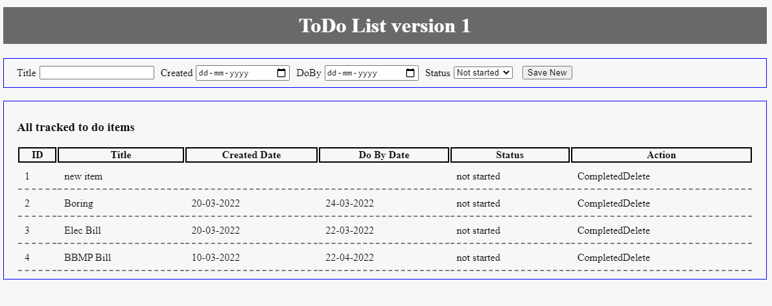
GUI / Mockups ….2

Slide 10
Project Execution – High Level
1
User enters new to do item details
User clicks Save button
Program saves new entry to state
Program renders entire list of todos in separate component

Slide 11
Project Execution – High Level
4
User decides to change status of todo
User clicks Completed link in todo
Program passes value up to main component
Program updates state for specific todo
Program renders list of todos in separate component

Slide 12
Project Execution – High Level
5
Select scheme name from Dropdown`
User clicks update button
User clicks clear/reset
Program pulls data from JSON
Program wipes data from all tables and variables
Program filters data based on selected scheme
Program displays data & totals
Program displays includes selected date data for comparing
User Selected date for comparison

Slide 13
Project Execution – High Level
6
Select scheme name from Dropdown`
User clicks update button
User clicks clear/reset
Does selection exist in Selected provider list, do nothing
Program wipes data from all tables and variables
Selected provider gets added to an array
Program pulls data from JSON
Program filters data based on selected scheme
Program displays data & totals
Program displays includes selected date data for comparing
User Selected date for comparison

Slide 14
Project Execution – High Level
7
Select scheme name from Dropdown`
User clicks update button
User clicks clear/reset
User changes date for comparison
Does selection exist in Selected provider list, do nothing
Program wipes data from all tables and variables
Program wipes data from all tables and variables
Selected provider gets added to an array
Program Loops over each entry in selected provider table
Program pulls data from JSON
Program filters data based on selected scheme
Program displays data & totals
Program displays includes selected date data for comparing
User Selected date for comparison

Slide 15
Project Execution – High Level
Data stored in “myFundList” (backward compatibility)
Data stored in master –” tmp”
Data pulled from localStorage
8
Select Fund House name from Dropdown
User clicks update button
User clicks clear/reset
User changes date for comparison
Does selection exist in Selected provider list, do nothing
Program wipes data from all tables and variables
Program wipes data from all tables and variables
Selected provider gets added to an array
Program Loops over each entry in selected provider table
Program pulls data from JSON
Program filters data based on selected scheme
Program displays data & totals
Program displays includes selected date data for comparing
User Selected date for comparison
User clicks on scheme name, open modal to show trends for 20 days

Slide 16
Project Execution – High Level, All Vs Specific fund selection
Data stored in “myFundList” (backward compatibility)
Data stored in master –” tmp”
Data pulled from localStorage
9
Select Fund House name from Dropdown
User clicks update button
User selects All?
Y
Clear/ Reset Selection array
N
Does selection exist in Selected provider list, do nothing
Loop over all data from localstorage
Selected provider gets added to an Selection array
Each provider gets added to an array
Program pulls data from JSON
Program pulls data from JSON
Update FundHouse subtotal
Update All FundHouse’s subtotal
Update All FundHouse’s subtotal

Slide 17
Pseudo Code and Code Samples

Slide 18
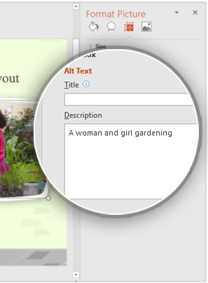
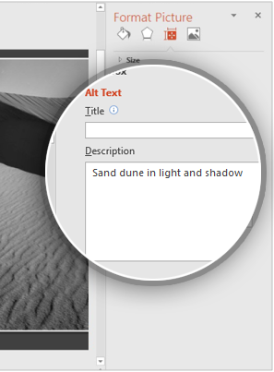
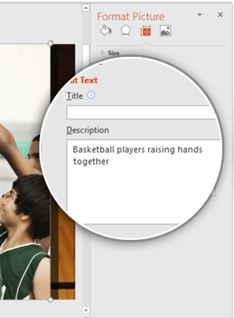
GUI / Mockups
1
2
3

Slide 19
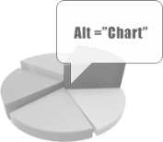
Alt Text Accessibility Rules – Charts
All charts also need to have alt text. To add alt text to a chart, right click on the chart and select Format Chart Area which will open the Format Chart Area pane, then go to Size & Properties > Alt Text and enter your alt text only into the Description field.
Alt text examples for two different chart types on this slide:
1
Line chart showing values of three series for four categories
2
Clustered column chart showing values of three series for four categories
1
2
Learn more about adding alt text to charts

Slide 20
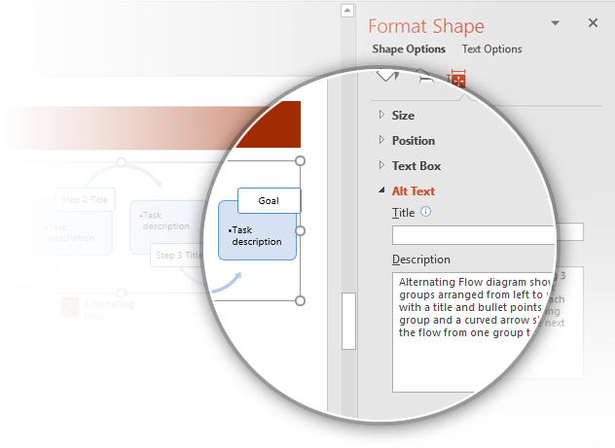
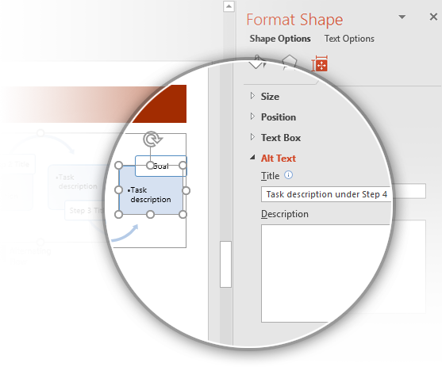

Alt Text Accessibility Rules – SmartArt
Alt text should be added to SmartArt diagrams on both grouped and sub-grouped objects. For grouped objects, only add alt text in the Description field. For sub-grouped objects, only add alt text in the Title field. Here are some alt text examples for SmartArt diagrams:
1
Text example for a grouped SmartArt diagram:
“Alternating Flow diagram showing 3 groups arranged from left to right with a title and bullet points in each group and a curved arrow showing the flow from one group to the next.”
To add alt text to a grouped SmartArt diagram, right click on the diagram and select Format Object > Size & Properties > Alt Text > Description
1
2
Text example for a sub-grouped SmartArt object:
“Task description under Step 4”
To add alt text for grouped objects inside of SmartArt diagrams, right click on the object and select Format Object > Size & Properties > Alt Text > Title
Learn more about adding alt text to SmartArt graphics
2

Slide 21
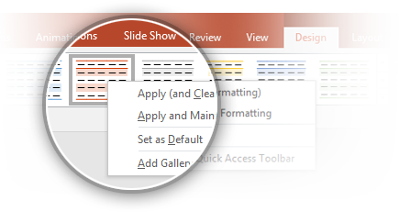

Accessibility Rules – Tables
First make sure there are no blank cells in your table. All table cells need to have content for screen readers to read.
Next run the color contrast analyzer tool on your table. You might need to change the design from the default colors to make them accessible.
Class | Group 1 | Group 2
Class 1 | 82 | 95
Class 2 | 76 | 88
Class 3 | 84 | 90
Tip: Tables should not have any alt text on either the title or description because it causes an error in screen readers. This will cause an error in the Accessibility checker which can be ignored.
If you change the table style, remember to set the new style as the default. To do this, select the table and go to Table Tools > Design > Table Styles, right click on the style you are using and select Set as Default.
Learn more about Accessibility best practices

Slide 22
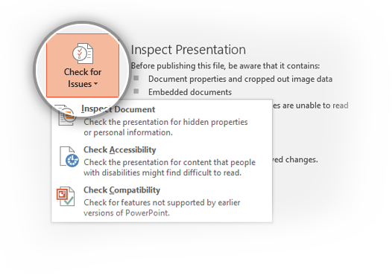
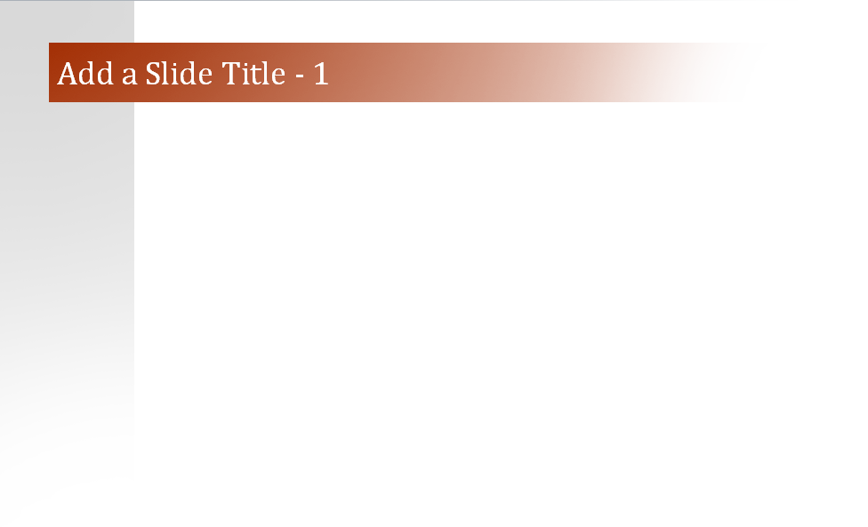

Basic Accessibility Rules
1
The Accessibility Checker should pass without errors on accessible templates. To run the Accessibility Checker, go to File > Check for Issues > Check Accessibility.
2
Every slide needs a unique title. You can use the text "Add a Slide Title - 1“ if you don’t have a specific title, and then you can increase the number for every slide.
1
2
Learn more about using the Accessibility Checker
Learn more about using unique slide titles

Slide 23
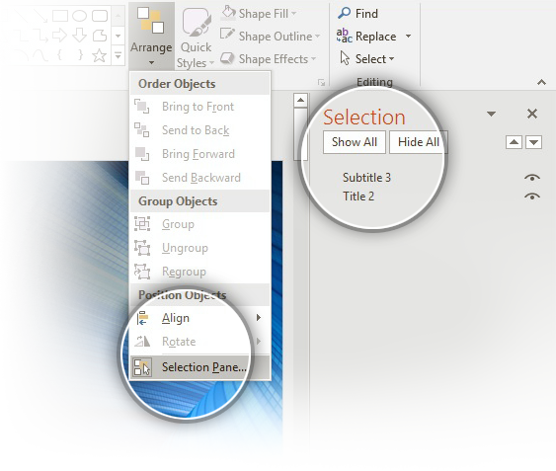
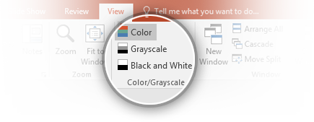
Basic Accessibility Rules….continued
3
Whenever there is text in front of a color, there has to be enough contrast between the foreground and background. The guideline is a ratio of 4.5:1 for normal text and 3:1 for large text (>= 18 pt font size)
Tip: Not all graphic elements need to pass the Accessibility Checker tool; only graphics that appear behind text.
6
The reading order has to be correct for all slides, in both the Master and sample slides. To change the reading order, go to Home > Drawing > Arrange > Selection Pane.
Read more about setting the reading order of slide contents
6
4
Make sure templates are readable in Black and White, Grayscale, and Color views in both the Master and sample slides.
4
5
Screen readers often read file names out loud to users so your template needs to have an appropriate name for easy searching.
7
Font sizes need to be 11pts or larger for readability.

Slide 24
Learn More
More questions about Accessibility?
Visit the PowerPoint Accessibility Support page.
→

Slide 25
Original Template After this

Slide 26
Making Templates Accessible

Slide 27
Contents
This template is designed to be used as a template as well as a guide to make your own accessible templates. Check out the Accessibility tips on the following pages. Contents of this guide are listed below:
Color accessibility rules – Charts and SmartArt
Alt text accessibility rules – Picture
Alt text accessibility rules – Chart
Alt text accessibility rules – SmartArt
Accessibility rules – Table
Basic Accessibility Rules

Slide 28
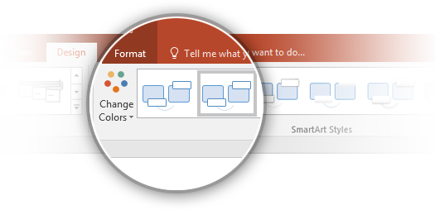
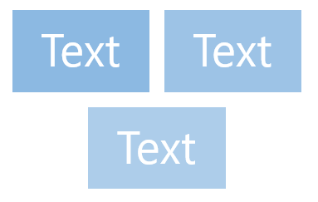
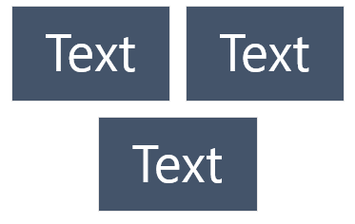

Color Accessibility Rules – Charts and SmartArt
1
Some people can’t see certain colors, so text, tables, and SmartArt need to pass a test that measures these color differences. You can download a color contrast analyzer from the web. To test using this tool, just select the color foreground and background you need and see if it passes!
2
If colors need to be changed to pass the analyzer, change the chart design or color scheme instead of changing the colors directly. To change these, select your chart and go to Chart Tools > Design > Chart Styles or Change Colors.
1
2
Failing color contrast
✓
Passing color contrast
Learn about accessibility best practices

Slide 29
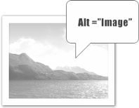
Alt Text Accessibility Rules – Pictures
All your pictures and tables need appropriate descriptive alternative text (known as “alt text”) that doesn’t use the words “photo” or “graphic”.
To add alt text, right click on your picture and select Format Picture, then go to Size & Properties > Alt Text and add alt text only to the Description field.
Alt text examples for pictures on this slide:
1
A women and girl gardening
1
2
Sand dune in light and shadow
3
Basketball players raising hands together
2
3
Learn more about adding alt text to images

Slide 30
Alt Text Accessibility Rules – Charts
All charts also need to have alt text. To add alt text to a chart, right click on the chart and select Format Chart Area which will open the Format Chart Area pane, then go to Size & Properties > Alt Text and enter your alt text only into the Description field.
Alt text examples for two different chart types on this slide:
1
Line chart showing values of three series for four categories
2
Clustered column chart showing values of three series for four categories
1
2
Learn more about adding alt text to charts

Slide 31
Alt Text Accessibility Rules – SmartArt
Alt text should be added to SmartArt diagrams on both grouped and sub-grouped objects. For grouped objects, only add alt text in the Description field. For sub-grouped objects, only add alt text in the Title field. Here are some alt text examples for SmartArt diagrams:
1
Text example for a grouped SmartArt diagram:
“Alternating Flow diagram showing 3 groups arranged from left to right with a title and bullet points in each group and a curved arrow showing the flow from one group to the next.”
To add alt text to a grouped SmartArt diagram, right click on the diagram and select Format Object > Size & Properties > Alt Text > Description
1
2
Text example for a sub-grouped SmartArt object:
“Task description under Step 4”
To add alt text for grouped objects inside of SmartArt diagrams, right click on the object and select Format Object > Size & Properties > Alt Text > Title
Learn more about adding alt text to SmartArt graphics
2

Slide 32
Accessibility Rules – Tables
First make sure there are no blank cells in your table. All table cells need to have content for screen readers to read.
Next run the color contrast analyzer tool on your table. You might need to change the design from the default colors to make them accessible.
Class | Group 1 | Group 2
Class 1 | 82 | 95
Class 2 | 76 | 88
Class 3 | 84 | 90
Tip: Tables should not have any alt text on either the title or description because it causes an error in screen readers. This will cause an error in the Accessibility checker which can be ignored.
If you change the table style, remember to set the new style as the default. To do this, select the table and go to Table Tools > Design > Table Styles, right click on the style you are using and select Set as Default.
Learn more about Accessibility best practices

Slide 33
Basic Accessibility Rules
1
The Accessibility Checker should pass without errors on accessible templates. To run the Accessibility Checker, go to File > Check for Issues > Check Accessibility.
2
Every slide needs a unique title. You can use the text "Add a Slide Title - 1“ if you don’t have a specific title, and then you can increase the number for every slide.
1
2
Learn more about using the Accessibility Checker
Learn more about using unique slide titles

Slide 34
Basic Accessibility Rules….continued
3
Whenever there is text in front of a color, there has to be enough contrast between the foreground and background. The guideline is a ratio of 4.5:1 for normal text and 3:1 for large text (>= 18 pt font size)
Tip: Not all graphic elements need to pass the Accessibility Checker tool; only graphics that appear behind text.
6
The reading order has to be correct for all slides, in both the Master and sample slides. To change the reading order, go to Home > Drawing > Arrange > Selection Pane.
Read more about setting the reading order of slide contents
6
4
Make sure templates are readable in Black and White, Grayscale, and Color views in both the Master and sample slides.
4
5
Screen readers often read file names out loud to users so your template needs to have an appropriate name for easy searching.
7
Font sizes need to be 11pts or larger for readability.

Slide 35
Learn More
More questions about Accessibility?
Visit the PowerPoint Accessibility Support page.
→

